Slide 1
Southern DPS Green Sturgeon
(Acipenser medirostris) and White Sturgeon (Acipenser transmontanus) Seasonal Movement Patterns and Migratory Behavior in the Sacramento-San Joaquin Delta
Marc Beccio¹, Colin Purdy¹, and John Kelly²
¹California Department of Fish and Wildlife, North Central Region Anadromous Fisheries, 1701 Nimbus Road,
Rancho Cordova, CA 95670
² California Department of Fish and Wildlife, Fisheries Branch, 830 S Street, Sacramento, CA 95811

Slide 2
Background and Objectives
The (sDPS) North American Green Sturgeon (Acipenser medirostris) population was listed as threatened by the National Marine Fisheries Service (NMFS) on 7 April 2006 (71 FR 17757). Critical habitat designated 9 October 2009. Recovery Plan published August 2018.
Demographic Recovery Criteria items 3 and 4 specify that recovery of sDPS Green Sturgeon is determined by:
  A net positive trend in juvenile and subadult abundance
  The population is characterized by broad distribution of size classes representing multiple cohorts that are stable over the long term
The lack of information on juvenile sDPS Green Sturgeon migration timing, survival, and transition rates throughout the lower Sacramento River and SFBDE is problematic from a species management perspective. Data collected from this study is necessary for understanding effects water operations and managing increased drought-related risks.

Slide 3
Background and Objectives
Southern DPS green sturgeon spawn in the Sacramento River from RK 426 downstream to RK 332.5 (Poytress et al 2011); (Brown 2007) and periodically in the Feather River (Seesholtz et al 2014) and Yuba River (M. Beccio, CDFW 2018 unpublished data).
Juvenile sDPS Green Sturgeon are thought to rear for up to three years throughout the lower Sacramento River and SFBDE before emigrating to the Pacific Ocean (Moyle 2002).
However, there is little information on specific movement and emigration patterns of juvenile sDPS Green Sturgeon and White Sturgeon for these locations.
The purpose of this study is to document seasonal movement, emigration patterns, and rearing habitat preferences for juvenile sturgeon in the SFBDE by tagging up to 100 sDPS juvenile Green Sturgeon and 100 juvenile White Sturgeon annually and track their spatial and temporal movement patterns using biotelemetry.

Slide 4
Methods
Initial sampling site selection based on factors such as historical juvenile sturgeon capture locations, channel width, depth, tidal phase, current velocity, bottom contour, submerged vegetation, etc. (Figure 1).
CPUE and drifting aquatic vegetation were ultimately the principal factors influencing sampling site selection; Site 7 was selected as the primary sampling site in late fall 2017.
Sampling is conducted by deploying two 30.5-meter variable mesh gill nets anchored with 18-kg pyramid weights.
Net soak times ranged from 60 to 240 minutes per NMFS protocol for sampling Green Sturgeon (Kahn and Mohead 2010).

Slide 5
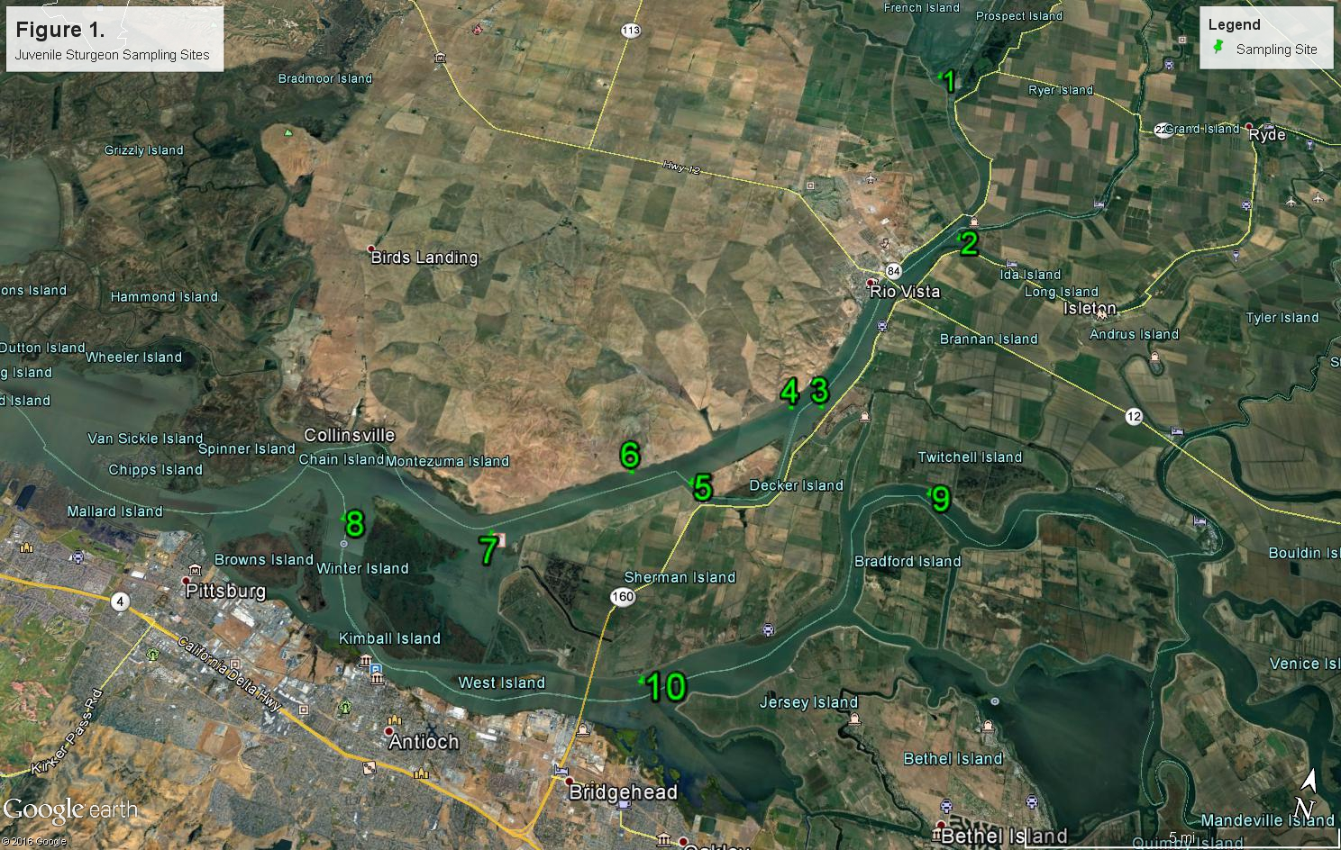

Slide 6
Methods
Captured juvenile sturgeon are measured, anesthetized, and surgically implanted with Vemco® V9 or V13 69 kHz acoustic transmitters.
All juvenile sturgeon captured beginning December 2018 are also tagged with passive integrated transponder (PIT) tags.
Genetic samples are collected from sDPS green sturgeon (fin clips).
CPUE calculated as the number of juvenile sturgeon captured per sampling event.
Bycatch identified to species and enumerated.

Slide 7
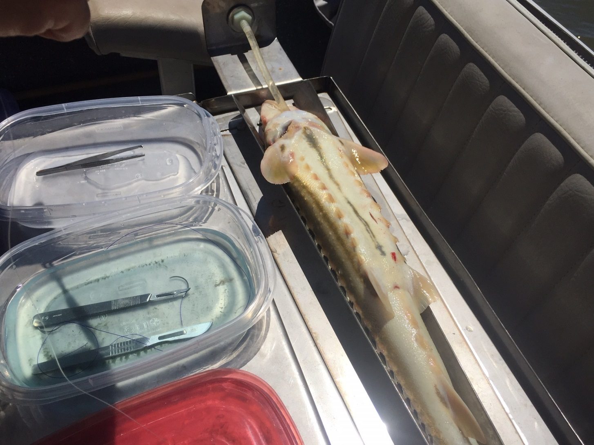

Slide 8
Methods
Detection data are downloaded from the 69-kHz acoustic receiver arrays deployed at various locations in the SFBDE and maintained by U.C. Davis Biotelemetry Lab, NMFS, and CDFW.
Beginning in August 2018, a Vemco® portable VR-100 69 kHz receiver was deployed during sampling to determine site residency.
CDFW recently deployed 69-kHz acoustic receivers in Threemile Slough, Sherman Lake, and Horseshoe Bend to determine fine-scale movement patterns and habitat utilization.

Slide 9
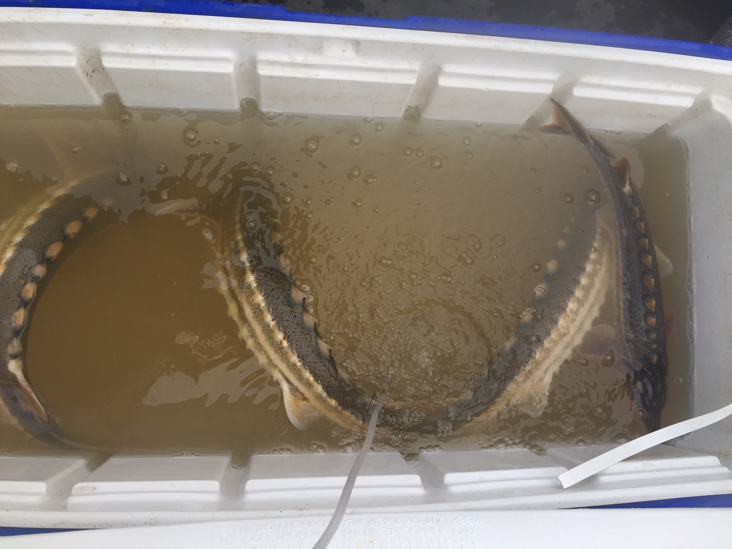
Results

Slide 10
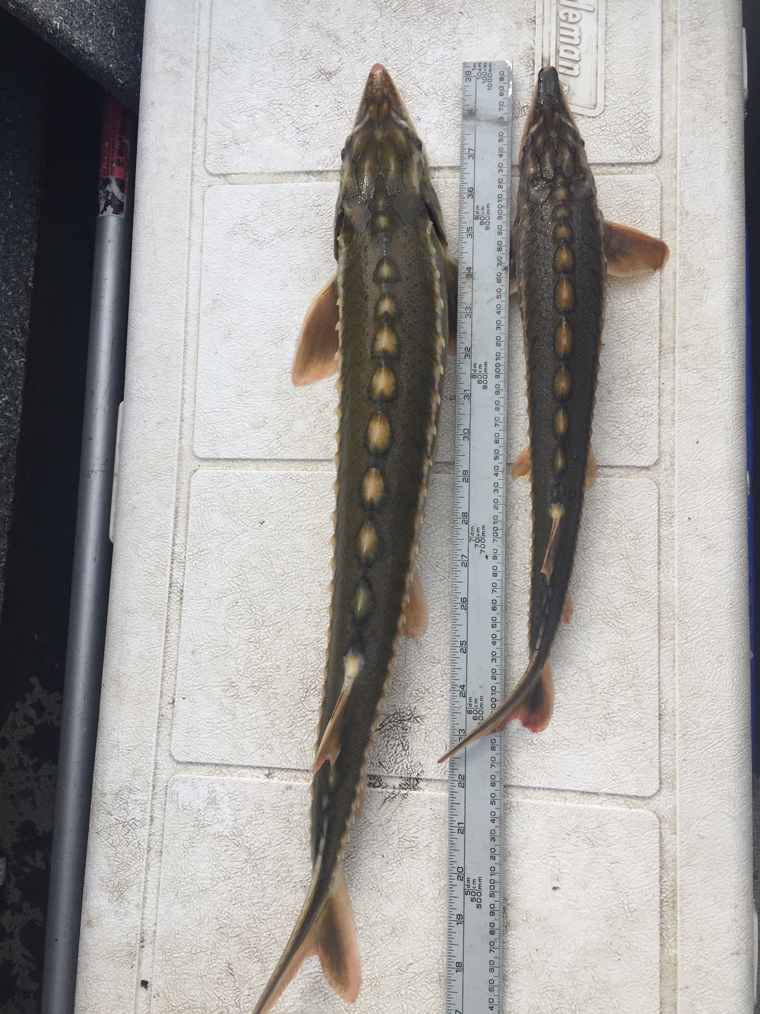

Slide 11
Juvenile sturgeon CPUE as sturgeon captured per sampling day; July 2015 through February 2019.
2015 |  | 2016 |  | 2017 |  | 2018 |  | 2019*
Sampling days |  | Sampling days |  | Sampling days |  | Sampling days |  | Sampling days
33 |  | 81 |  | 44 |  | 34 |  | 6
Number captured |  | Number captured |  | Number captured |  | Number captured |  | Number captured
Green | White | Green | White | Green | White | Green | White | Green | White
1 | 0 | 7 | 11 | 7 | 0 | 40 | 5 | 6 | 0
CPUE |  | CPUE |  | CPUE |  | CPUE |  | CPUE
0.03 | 0 | 0.09 | 0.14 | 0.16 | 0 | 1.18 | 0.15 | 1.00 | 0
Project totals to date: 61 sDPS Green Sturgeon; 16 White Sturgeon
Overall CPUE for juvenile sDPS green sturgeon increased substantially in 2018.
2018 capture data suggest strong recruitment of the 2017 brood year to the juvenile life stage.

Slide 12
Summary of juvenile sturgeon tagged by brood year, 2018-2019 sampling season.
Green Sturgeon
Brood year¹ | 2015 | 2016 | 2017 | 2018² | Total
Number tagged (% of total) | 1 (2.4) | 6 (14.6) | 32 (78.0) | 2 (4.9) | 41
Mean Fork Length (cm) | 94 | 66.1 | 51.4 | 40.2
White Sturgeon
Brood year | 2015 | 2016 | 2017 | 2018 | Total
Number tagged (% of total) | 1 (20) | 2 (40) | 2 (40) | 0 | 5
Mean Fork Length (cm) | 81 | 60.2 | 48.5 | ---
Four distinct brood-year classes of Green Sturgeon encountered during 2018 and early 2019 sampling seasons.
¹ Brood year based on laboratory growth rates of nDPS Green Sturgeon, (Allen et. al. 2011), (Mayfield and Cech 2004), and capture of age-0 of sDPS Green Sturgeon in the upper Sacramento River (Poytress 2015).
² Both fish tagged 7 February 2019.

Slide 13
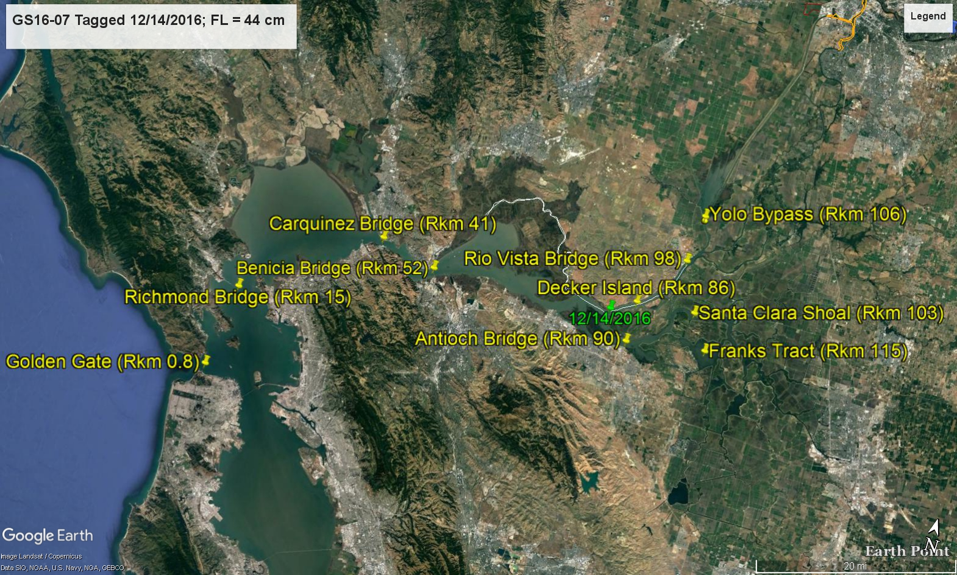
GS16-07; Fork Length 44 cm; Tagged 12/14/2016. Decker Island 12/14/2016; Benicia Bridge 12/20/2016; Carquinez Bridge 12/21/2016 to 7/22/2017; Richmond Bridge 7/28 to 11/27/2017; Golden Gate Array 11/29 to 12/02/2017.

Slide 14
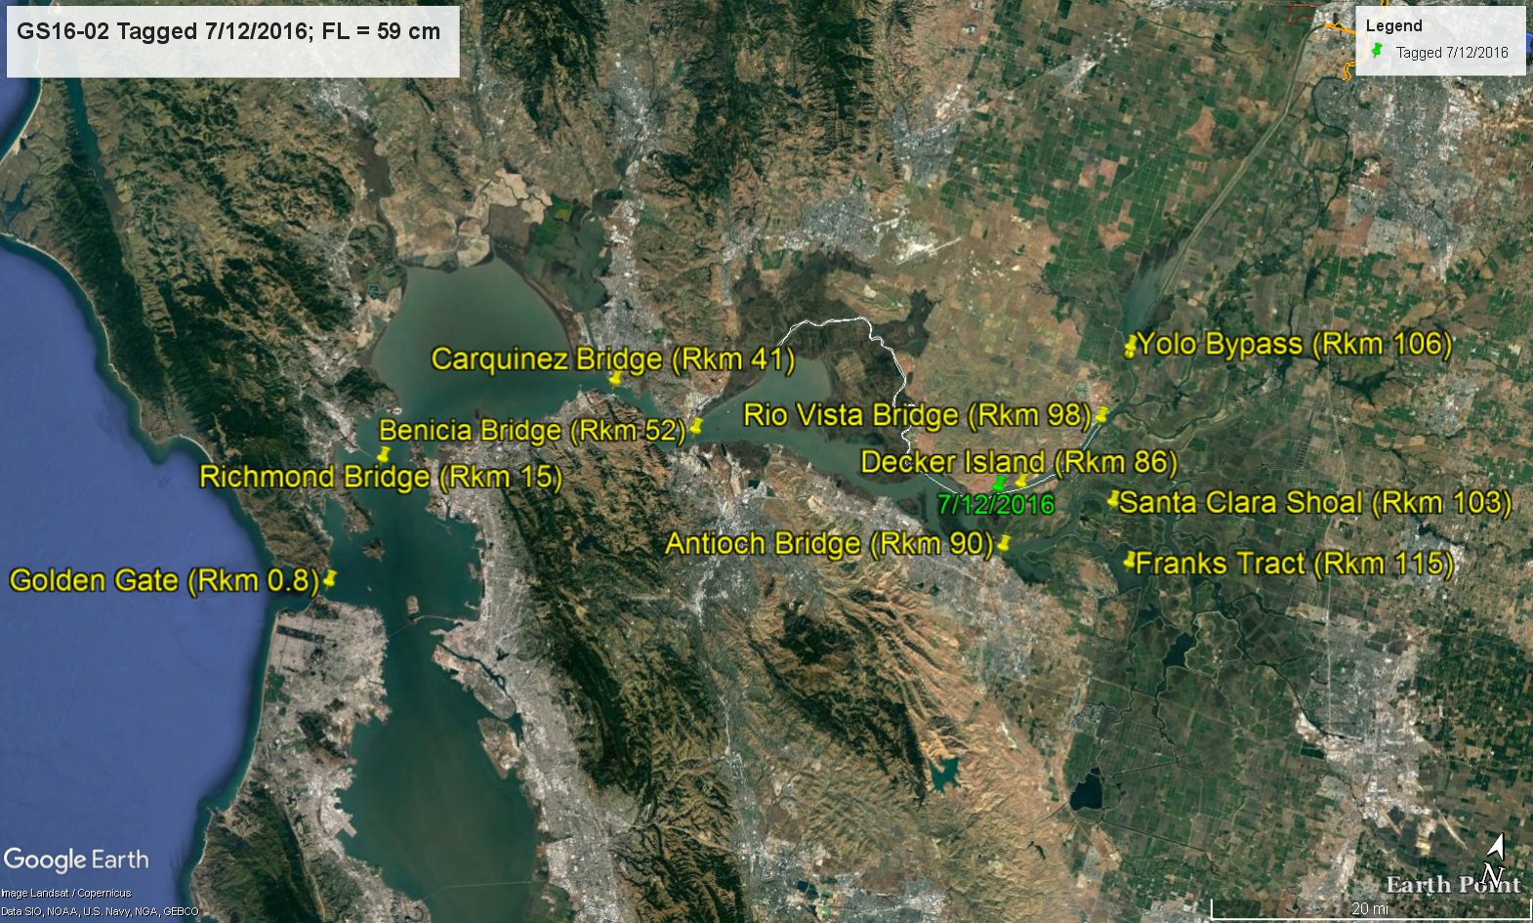
GS16-02; Fork Length 59 cm; Tagged 7/12/2016. Decker Island 7/12 to 10/01/2016; Benicia Bridge 11/18 to 11/30/2018; Carquinez Bridge 11/30 to 12/05/2016; Richmond Bridge 12/07/2016; Golden Gate Array 12/25/2016 to 1/07/2017; Richmond Bridge 1/13 to 1/16/2017; Golden Gate Array 1/20 to 5/12/2017 (intermittent).

Slide 15

GS16-03; Fork Length 62.5cm; Tagged 7/14/2016. Rio Vista Bridge 7/14 to 9/04/2017; Decker Island 9/07/2016; Rio Vista Bridge 9/20/2016; Decker Island 9/20 to 10/01/2016; Benicia Bridge 10/05 to 11/07/2016; Carquinez Bridge 11/12/2016; Benicia Bridge 11/13/2016; Antioch Bridge 11/16/2016; Santa Clara Shoal 11/16/2016; Antioch Bridge 11/18/2016; Benicia Bridge 11/25 to 11/28/2016; Carquinez Bridge 11/30 to 12/04/2016; Richmond Bridge 12/06/2016 to 3/25/2017; Benicia Bridge 3/26/2017; Carquinez Bridge 3/27/2017; Antioch Bridge 3/30/2017; Santa Clara Shoal 3/30/2017; Antioch Bridge 4/01/2017; Decker Island 4/02/2017; Rio Vista Bridge 4/05/2017; Decker Island 4/05 to 4/07/2017; Benicia Bridge 4/09 to 4/11/2017; Carquinez Bridge 4/15/2017 to 5/10/2017; Richmond Bridge 7/18/2017.

Slide 16
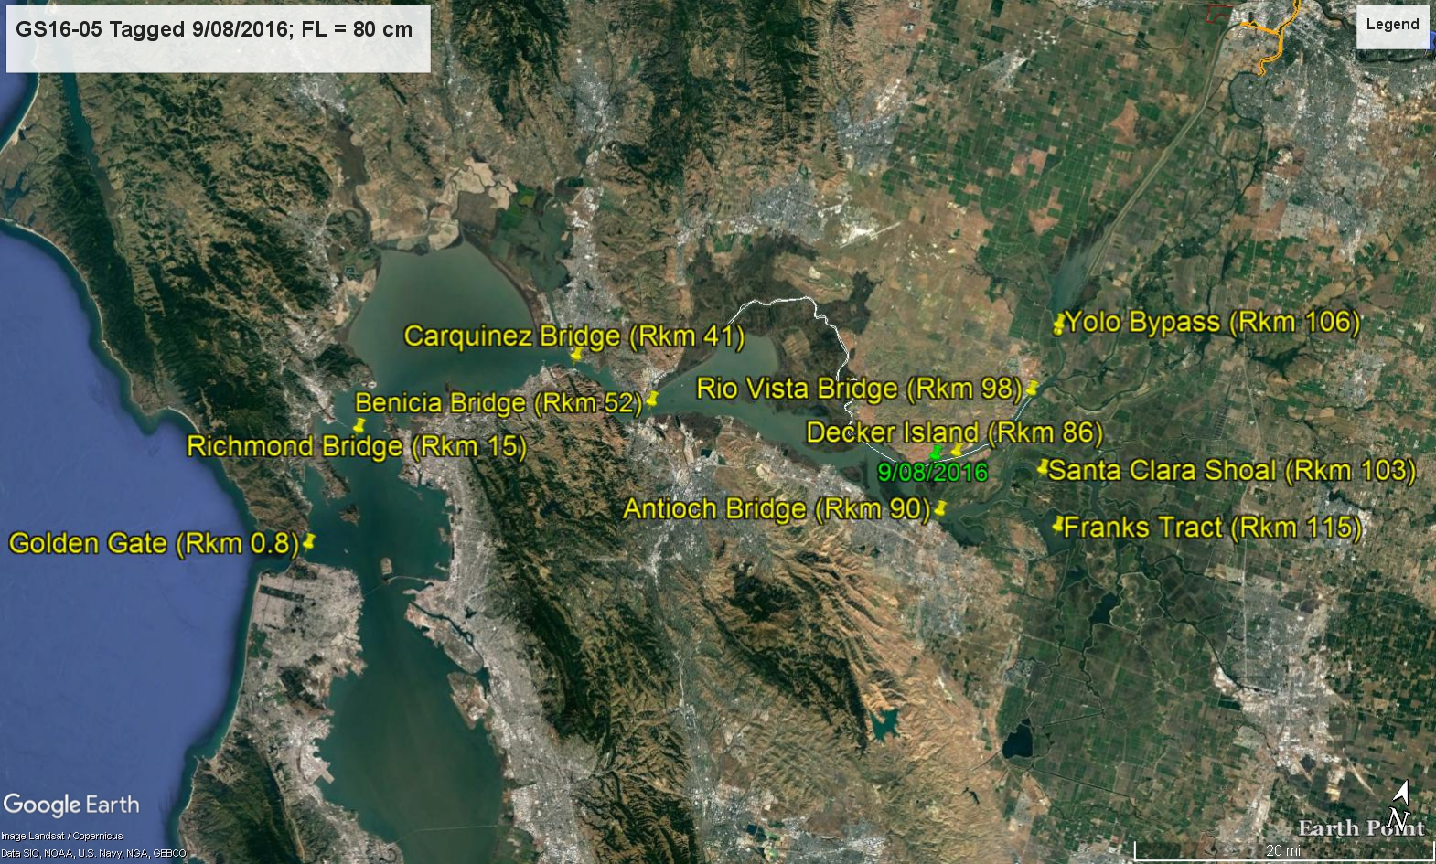
GS16-05; Fork Length 80 cm; Tagged 9/08/2016. Decker Island 9/08 to 9/18/2016; Benicia Bridge 9/25/2016; Carquinez Bridge 9/25/2016; Richmond Bridge 9/24 to 10/29/2016; Golden Gate Array 11/01/2016; Carquinez Bridge 11/09 to 11/11/2016; Benicia Bridge 11/12 to 11/16/2016; Carquinez Bridge 11/16/2016; Golden Gate Array 11/27 to 1/19/2017.

Slide 17

WS16-06; Fork Length 33 cm; Tagged 9/13/2016. Decker Island 9/13/2016; Rio Vista Bridge 9/14/2016; Yolo Bypass 9/14/2016; Decker Island 9/20 to 11/16/2016; Antioch Bridge 11/29/2016; Benicia Bridge 12/15 to 12/18/2016; Antioch Bridge 3/10/2017; Franks Tract 3/11/2017; Benicia Bridge 3/13/2017; Carquinez Bridge 3/16 to 3/18/2017; Antioch Bridge 7/20/2017; Decker Island 7/21 to 9/18/2017; Rio Vista Bridge 9/19/2016.

Slide 18
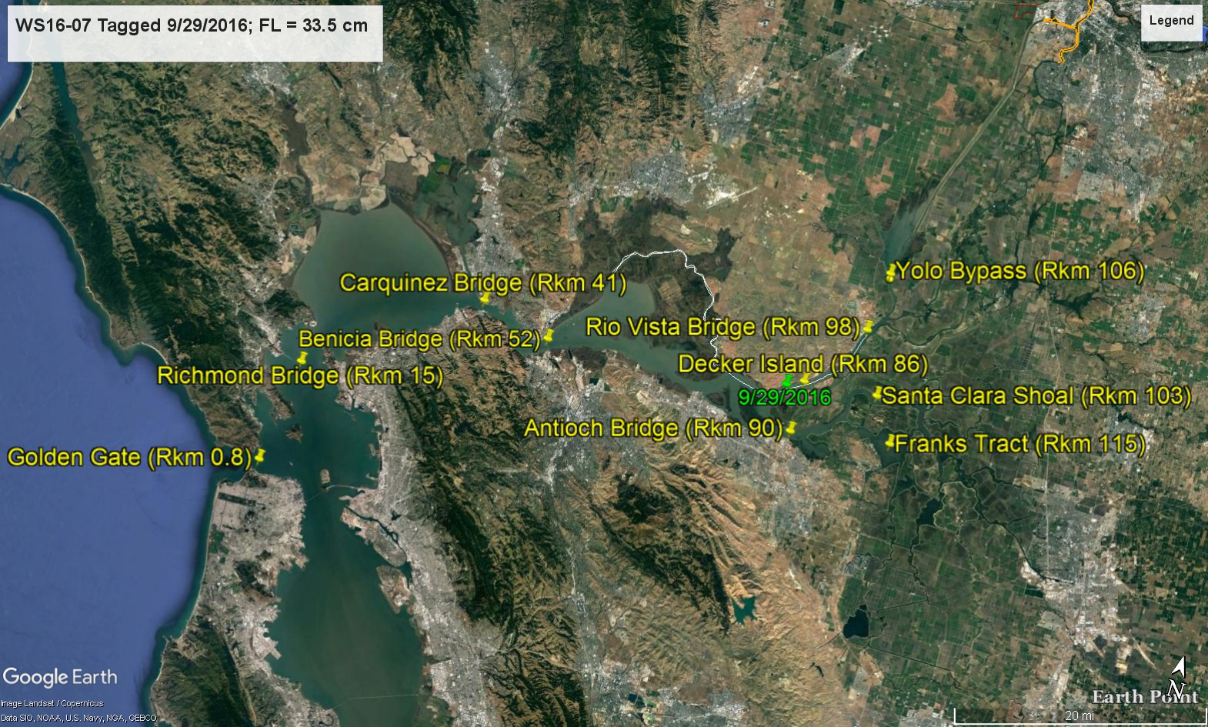
WS16-07; Tagged 9/29/2016. Decker Island 9/29 to 11/21/2016; Benicia Bridge 11/27 to 12/16/2016; Carquinez Bridge 12/7, 12/12, 12/20/2016; Decker Island 12/22/2016; Rio Vista Bridge 12/24/2016; Decker Island 12/27 to 12/30/2016; Benicia Bridge 4/17 to 4/24/2017; Antioch Bridge 4/28/2017; Franks Tract 4/29/2017; Antioch Bridge 5/1/2017; Benicia Bridge 5/2 to 5/8/2017; Carquinez Bridge 5/12/2017.

Slide 19
Juvenile sDPS Green Sturgeon detections, Tagging Site Residency and Benicia Bridge Detections, 2018-2019.
2018 Tagging Site Residency Data (through 02/07/2019)
Brood year | 2015 | 2016 | 2017
Number of fish | 1 (1) | 5 (6) | 20 (28)
Range (days) | 0 | 2 to 133 | 9 to 135
Mean | 0 | 48 | 57
Initial Detection at Benicia Bridge (though 01/28/2019)
Brood year | 2015 | 2016 | 2017
Number of fish | 1 (1) | 4 (6) | 10 (28)
Range (days) | 7 | 3 to 71 | 28 to 115
Mean | 7 | 35 | 65
Residency at Benicia Bridge (though 01/28/2019)
Brood year | 2015 | 2016 | 2017
Number of fish | 1 (1) | 4 (6) | 10 (28)
Range (days) | 1 | 1 to 31 | 1 to 22
Mean | 1 | 9 | 6
Four 2017 brood year sDPS Green Sturgeon tagged in 2018 were detected at Antioch Bridge with a range of 9 to 120 days after tagging.
One 2017 brood year Green Sturgeon tagged in 2018 detected at bottom of the Yolo Bypass (Rkm 106) 36 to 73 days after tagging; Benicia Bridge 115 days after tagging.

Slide 20
Discussion
Substantial increase in 2018 and early 2019 CPUE of juvenile sDPS Green Sturgeon is likely a result of strong recruitment during 2017 water year but may also be related to a refinement in sampling methods.
CPUE for juvenile White Sturgeon at Site 7 suggests considerable differences in movement patterns or habitat preference between species.
Juveniles of both sturgeon species move between the Sacramento and San Joaquin reaches of the SFBDE, as well as making seasonal migrations within the SFBDE.
At least some juvenile sDPS Green Sturgeon appear to return to the SFBDE after short duration ocean forays.

Slide 21
Discussion
Changes in water quality parameters resulting from water operations could result in changes in seasonal movement and migratory behavior for both sturgeon species.
Movement of juvenile sDPS Green Sturgeon into the central delta could increase the potential for entrainment by the CVP and SWP.
Receivers deployed in Threemile Slough, Sherman Lake, Horseshoe Bend, Montezuma Slough, and the Deep Water Shipping Channel should provide fine-scale detection data regarding seasonal movement routes and habitat utilization for both sturgeon species.

Slide 22
Future work
Deploy more 69 kHz receivers (e.g., Montezuma Slough, Deep Water Shipping Channel) to more fine-scale detection data regarding seasonal movement routes and habitat utilization for both sturgeon species.
Manual tracking to elucidate daily movement patterns.
Consider a long-term sampling program to provide annual estimation of sDPS Green Sturgeon recruitment to the juvenile life stage to track Demographic Recovery Criteria parameters 3 and 4:
  A net positive trend in juvenile and subadult abundance
  The population is characterized by broad distribution of size classes representing multiple cohorts that are stable over the long term

Slide 23
Acknowledgments
This study is funded in part by National Marine Fisheries Section 6 Grant NA18NMF4720097 (July 1, 2018 through June 30, 2021).
Kevin Afinson, Leslie Alber, Aimee Braddock, Skyler Burson, Russ Bellmer, Jordan Butler, Kevin Cahill, Jimmy Carlson, Rebekah Christianson, Phil Clark, Nathan Cutler, Nicole Dunkley, Mike Eakin, Lauren Estenson, Ben Ewing, Don Evans, Emily Fisher, Mike Gillingham, Joe Ferreira, John Hanson, Mike Healy, Justin Healy, Michelle Holtz, Sean Hoobler, Larry Houghtby, Emily Jacinto, Jeffery Joslyn-Carter, Jason Julienne, Brian Karabinos, John Kelly, Shig Kubo, Wayne Laessig, Alison Lane, Veronica Larwood, Alex Laughtin, Josef Lehr, Juan Lopez-Torres, Sarah Lose, Duane Linander, Daniel Macias, Paul Macias, Kasey Macrae, Lillian McDougall, Chris McKibbin, Ryan McKim, Margaux McClure, Dmitry Melnik, Nick Miguel, Michael Navicky, Aaron Neely, Carol Oz, Oliver Patton, Cameron Reyes, Lanette Richardson, Chadwick Richardson, Sadao, Geoffrey Schroeder, Bjarni Serup, Kursten Sheridan, Tanya Sheya, Mike Thomas, Kenny Tran, Page Vick, and Casey Williams.

Slide 24
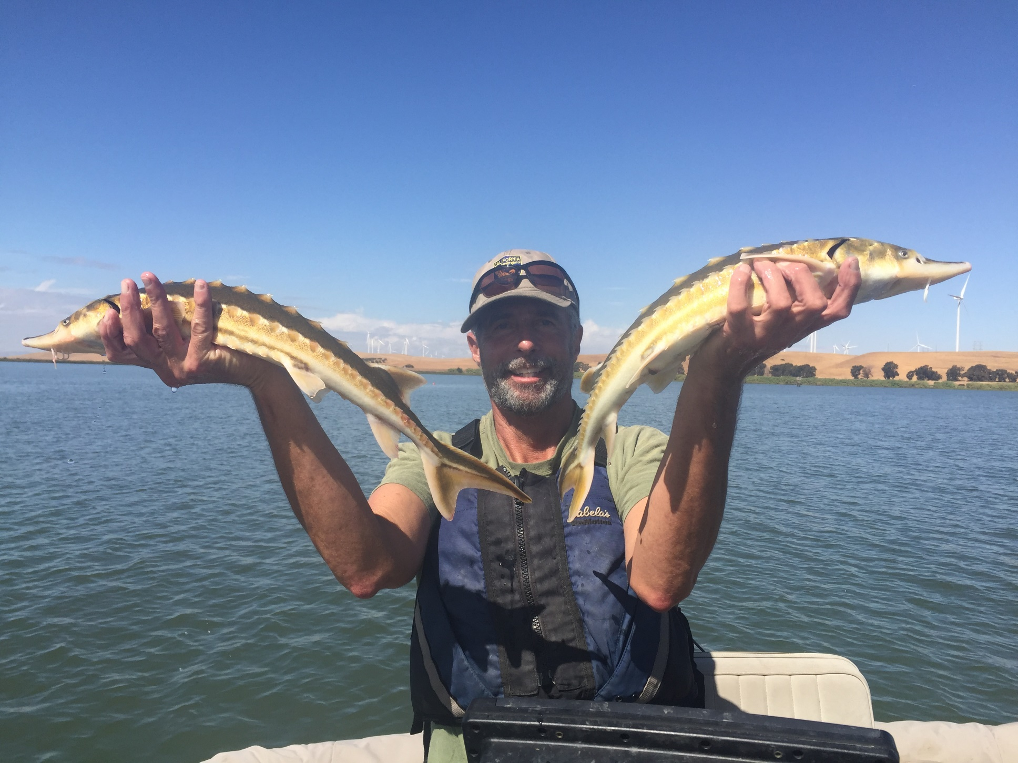
Questions?

